Slide 1
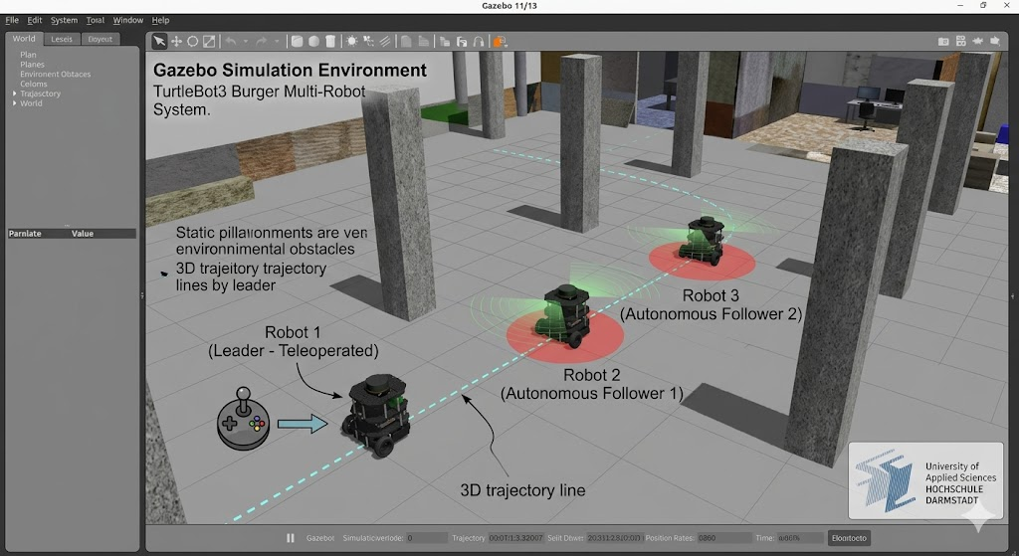
Project Title Multi-Robot TurtleBot3 Burger Leader–Follower System in a Simulated Environment Statement of Work (Scope & Deliverables)
Objective: Develop a ROS2-based Multi-Robot TurtleBot3 Burger Convoy System in a Gazebo simulation environment where multiple robots operate in a coordinated leader–follower formation.
System Behavior
Robot 1 (Leader): Manually controlled through teleoperation
Robot 2 & Robot 3 (Followers): Autonomously follow the robot ahead
Operating Environments
Empty simulation world
Obstacle world (columns/pillars)
Statement of Work (Scope & Deliverables)
Simulation & Environment Setup
Configure ROS2 Jazzy + Gazebo Harmonic
Develop Empty and Pillar worlds
Configure ROS–Gazebo topic bridges
System Architecture
Deploy 1 Leader + 2 Followers
Implement namespace isolation
Configure launch framework and robot spawning
ROS Node Development
teleop_controller.py
follower_node.py
laser_processor.py
safety_controller.py
Perception & Control
LiDAR data processing
Target identification and tracking
Obstacle rejection logic
Safety and collision avoidance
Image Generated by Gemini

Slide 2
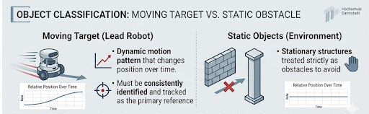
Technical Scope, Deliverables & Expected Outcome Core Technical Challenge
Differentiate between: Dynamic Target Lead robot Moving object Primary tracking reference
Static Objects Walls, columns, pillars Must be treated as obstacles
Deliverables 📦
ROS workspace and source code
Gazebo simulation worlds
Multi-robot ROS nodes/packages
System documentation
Test results and performance evaluation
Final presentation and demonstrations
Success Criteria ✅
Robot 1 controlled through teleoperation
Robot 2 & Robot 3 correctly follow preceding robot
Dynamic leader distinguished from static obstacles
Stable inter-robot distance maintained
Collision-free navigation achieved
Reliable operation in both simulation environments
Image Generated by Gemini

Slide 3
To Be Continued

